Slide 1


Info Day
Bulgaria
DRP 2nd CfP
07 March 2024, online
Johannes Gabriel
Senior Project Officer

Slide 2



State of play
DRP 2nd Call - one-step procedure
Only electronic submission through Jems
Call Deadline: 3rd April 2024, 14:00 Central European Time (CET)
Estimated starting date of the projects: January/February 2025
The duration of projects must not exceed 36 months

Slide 3
State of play
Allocated max. budget: EUR 38 750 000 EUR INTERREG funds
Maximum EU contribution co-financing rate: 80%
DRP covers the entire territory of Ukraine (UA) but UA partners can’t be LPs in the 2nd call

Slide 4

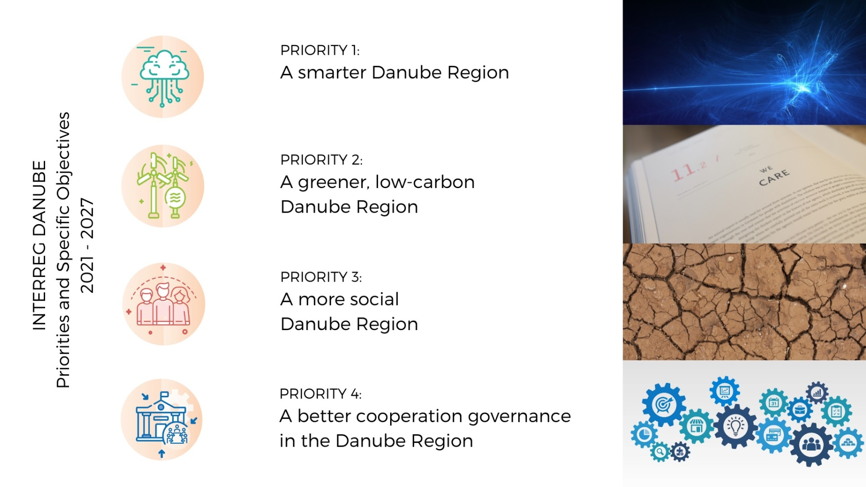
State of play
Please be aware that for the 2nd call Priority 1 and Specific Objective 2.1 are closed!

Slide 5
State of play

Slide 6
State of play
Read factsheets:
1. A smarter Danube Region
https://www.interreg-danube.eu/about-dtp/priorities-objectives-2021-2027/priority-1-smarter-danube-region
2. A greener, low-carbon Danube Region
https://www.interreg-danube.eu/about-dtp/priorities-objectives-2021-2027/priority-2-greener-low-carbon-danube-region
3. A more social Danube Region
https://www.interreg-danube.eu/about-dtp/priorities-objectives-2021-2027/priority-3-more-social-danube-region
4. A better cooperation governance: Increased institutional capacities for territorial and macroregional governance
https://www.interreg-danube.eu/about-dtp/priorities-objectives-2021-2027/priority-4-better-cooperation-governance-in-danube-region

Slide 7
State of play
Priority 2 – A greener, low-carbon Danube Region
SO 2.1 Promoting renewable energy in accordance with directive (EU) 2018/2001, including the sustainable criteria set out therein
SO 2.2 Promoting climate change adaptation capacities in the Danube Region and disaster management on transnational level in relation to environmental risks, taking into account ecosystem-based approaches
SO 2.3 Sustainable, integrated, transnational water and sediment management in the Danube River Basin ensuring good quality and quantity of waters and sediment balance.
SO 2.4 Protecting and preserving the biodiversity in ecological corridors and eco-regions of transnational relevance in the Danube Region.

Slide 8

Priority 3 – A more social Danube Region
SO 3.1 - Accessible, inclusive and effective labour markets
SO 3.2 - Accessible and inclusive quality services in education, training and lifelong learning
SO 3.3 - Enhancing the role of culture and sustainable tourism in economic development, social inclusion and social innovation
State of play

Slide 9

State of play
S.O. 4.2 Increased institutional capacities for territorial and macro-regional governance
Focus:
-Integrated governance models for addressing challenges arising from demographic change (e.g. aging, depopulation, brain drain)
- Integrated urban-rural governance models including specific territorial development strategies for rural/remote areas
- Support for more and stronger inter-institutional relations for the integrated development of transboundary functional areas
- Capacity building considering especially a better involvement of local and regional public bodies as well as civic actors in transnational policy making, territorial development frameworks and governance models
- Support for the monitoring and analysis of territorial processes affecting the cohesion and cooperation of the Danube Region

Slide 10

What do we NOT finance
Projects without clear focus/”niche”
Projects without clear territorial scenario
Projects with pre-dominant focus on research and data collection activities without translating their outcomes into tangible results
Projects with pre-dominant focus on infrastructure

Slide 11
Important Documents
The application package and all relevant information about the 2nd CfP is available on the program website: http://www.interregdanube.eu.
The following official programme documents are to be read before the submission of a proposal:
Danube Region Programme document (IP)
Applicants’ Manual (Version 1.2 - date: October 2023)
Manual on Eligibility of Expenditure (Version 2.0 - date: October 2023)
Guidelines for filling in the AF (October 2023)
How to develop a transnational project

Slide 12
Other Support
The program provides supporting tools at the application stage (e.g. individual consultations) and events (e.g. thematic webinars, info days) to facilitate project generation and support applicants in the project development process.
For general advice on the program and compliance requirements and national regulations, please contact your national contact point.
For advice on the thematic focus of the project, please contact the programe MA/JS
danube@interreg-danube.eu

Slide 13
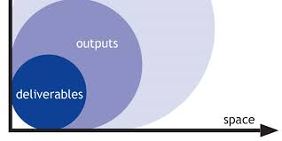
Intervention logic

Slide 14
Intervention logic
DRP
S.O.
Project
Objectives
Activities
Deliver-ables
Outputs
Output
Indicator
Result
Result
Indicator

Slide 15
Intervention logic
1 data-base
New, sustainable bottom-up governance model
Outputs
DRP
S.O. 4.2
Project
Objectives
Deliver-ables
Output
Indicator
Result
Result
Indicator
Activities
1 large conference for experts

Slide 16

Intervention logic
Output indicator Result indicator
RCO82 Participations in joint actions promoting gender equality, equal opportunities and social inclusion
RCR85 Participations in joint actions across borders after project completion
RCO 83 Strategies and action plans jointly developed
RCR 79 Joint strategies and action plans taken up by organisations
RCO 84 Pilot actions developed jointly and implemented in projects
ISI: Organisations with increased institutional capacity due to their participation in cooperation activities across borders, other than organisations counted under RCO 87 Organisations cooperating across borders (PPs, etc.) – e.g. organisations external to the partnership
RCO 116 Jointly developed solutions
RCR 104 Solutions taken up or up-scaled by organisations
RCO 87 Organisations cooperating across borders
ISI: Organisations with increased institutional capacity due to their participation in cooperation activities across borders
RCO120 Projects supporting cooperation across borders to develop urban-rural linkages

Slide 17
Intervention logic
ATTENTION: Projects have to contribute to at least two programme output and two result indicators to be considered eligible.
Output RCO 87 - Organisations cooperating across borders and the corresponding result indicator ISI “organisations with increased institutional capacity due to their participation in cooperation activities across borders” is mandatory for all the projects!

Slide 18
Intervention logic
Typical mistakes in project intervention logic
RCO 116 Jointly developed solutions
Jointly developed solutions cannot be counted as outputs if they are not the result of joint pilot action!
Jointly developed solutions which are not piloted/tested can be implemented, but then counted as deliverables only

Slide 19
Intervention logic
Some typical mistakes in project intervention logic
RCO 87 Organisations cooperating across borders
Formalised cooperation between independent based
Quantifiaction issues
The indicator counts the organisations cooperating formally in supported projects. The organisations counted in this indicator are the legal entities including project partners and associated strategic partners, as mentioned in the application form and subsidy contract.

Slide 20
Intervention logic
  Read carefully Annex 1 of Applicants Manual on output & result indicator definitions and their linkages:
  https://www.interreg-danube.eu/uploads/media/default/0001/57/eb0a742c65d6fd5a579075a602c376b2f3c66aba.pdf

Slide 21

Assessment

Slide 22
Assessment - Eligibility
Eligibility assessment
confirms the correctness of submitted infos and docs to the applicant
in timely manner (deadline) and
in formal manner (e.g. completeness)
Eligibility criteria are of “knock-out” nature
No subject of interpretation, possible answers just “YES” or “NO”

Slide 23
Assessment - Eligibility
PP criteria
Completeness of submitted partner documents
  Signed Partnership Agreement
For each PP the scans of the following docs to be uploaded filled in, signed and s canned:
  Declaration of co-financing
  State aid declaration
  Declaration for international organisations (if the case)
  Completeness of submitted ASP documents
  For each ASP a scan of the filled in, signed and scanned declaration of interest for ASP has to be uploaded to Jems.

Slide 24
Assessment - Quality
How is the AF assessed from a qualitative point of view?
Assessment procedure, assessment matrix and quality criteria are included in the:
  Applicants’ Manual
Please download it from the website :
https://www.interreg-danube.eu/uploads/media/default/0001/57/eb0a742c65d6fd5a579075a602c376b2f3c66aba.pdf
Please read the assessment sections thoroughly in order to prepare a high quality proposal!

Slide 25
Assessment - Quality
Quality criteria
are linked to the specific objectives and results of the Danube Region Programme document
are common to all Priorities
assessment will be carried out by the MA/JS

Slide 26
Assessment - Quality
Quality criteria groups:
Strategic assessment criteria: contribution to the programme’s objectives and to the programme’s result
Operational assessment criteria: viability and feasibility, value for money in terms of resources used against delivered outputs and results
Each criteria group is assessed on basis of different criteria with each being scored from 0 to 5.

Slide 27
Assessment - Quality
Strategic assessment is carried out first
Only projects successfully passing the strategic assessment are assessed operationally
The knock-out treshold is set at 60%:
  If a proposal receives a lower score than 60% in the strategic assessment, it will not be assessed operationally and it fails the overall assessment.
  If a proposal receives at least 60% in the strategic assessment, then it will be assessed also from an operational point of view.
  The final score (%) of the proposal will be given by the weighed sum of the strategic and operational assessment scores (%)
  Only project with a final score of 60% or more will be considered for funding

Slide 28
  www.interreg-danube.eu

